Slide 1
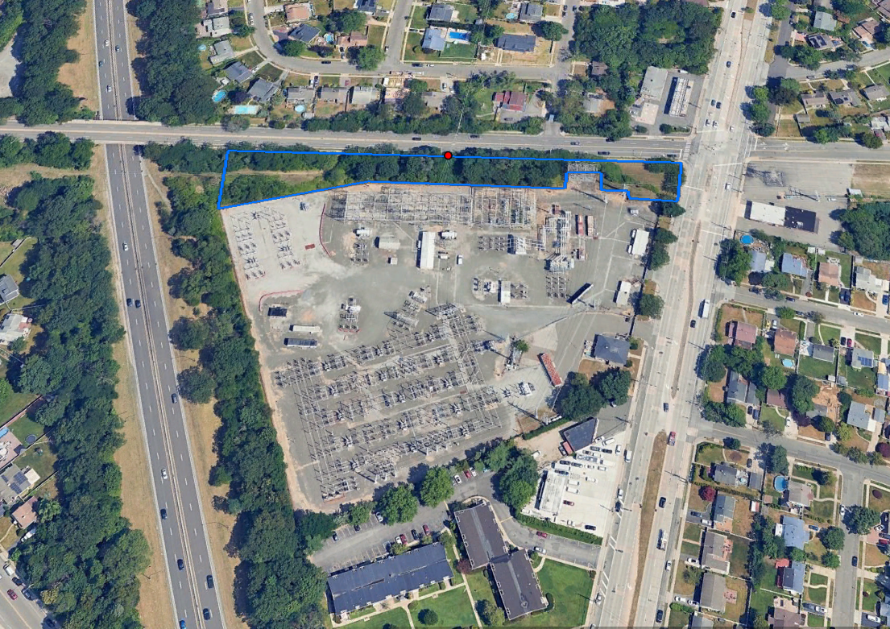
Newbridge Bypass Project
PSEG Long Island is committed to delivering best-in-class system reliability by expanding electrical capacity to meet the energy needs of the communities it serves, today and in the future.
Project Overview & Benefits
PSEG Long Island, as the agent of LIPA, is filing an application for an amendment to the Article VII certificate for Transmission Line 138-467 which connects the Stewart Avenue Substation in Uniondale to the Newbridge Substation in Levittown, as well as Transmission Line 138-567 which connects the Newbridge Substation to the Ruland Road Substation in Melville. The Newbridge Bypass Project would extend Transmission Line 138-467 to a new termination point, within LIPA-owned property, west of Stewart Avenue Substation, modify both lines to bypass the Newbridge Substation, and extend Transmission Line 138-567 east at the Ruland Road Substation within LIPA property.
The result would be the combining of the two existing lines into one, which will be operated at 345kV.
The line must be installed to meet current and future capacity needs and to continue the provision of safe, robust, and reliable service in the area.
Benefits Include:
The modified 345kV electric transmission line will help ensure continued reliable service to the area and across Long Island.
The modified line will be located entirely underground primarily under roads and rights-of-way except for certain above-ground electrical equipment within LIPA-owned property.
Throughout construction, access to businesses and residences along the project route will be maintained.
Newbridge Substation in which the Bypass Splice Vault will be located
New York State Public Service Commission Article VII Information
After the Project's amendment application is filed and the Commission assigns a case number to the Project, the case number will be provided on the Project's website. Then, the amendment application and related case documents can be accessed on the PSC website (www.dps.ny.gov) by clicking "File Search" and filling in the case number. This will bring up the main Document and Matter Management (“DMM”) page(s) for this case, where the materials are located.
In addition, interested persons who wish to participate as parties in this case may file for party status. On the DMM page for this case, the prospective party should click the button at the upper right labeled “Request for Party Status” to see a Public Service Commission web page with instructions for the procedures to follow to become a party.
For Questions About The Newbridge Bypass Project,
Call or Text 631-763-3122 Email info@NewbridgeBypass.com Visit www.NewbridgeBypass.com

Slide 2
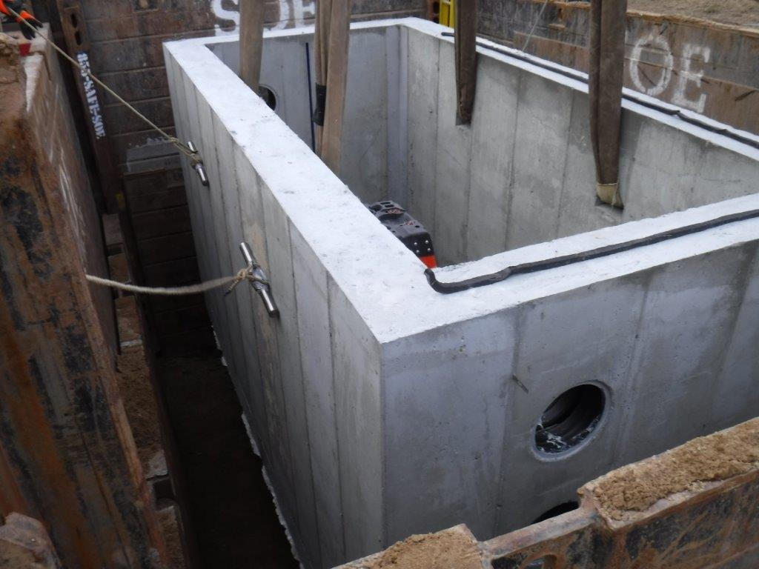
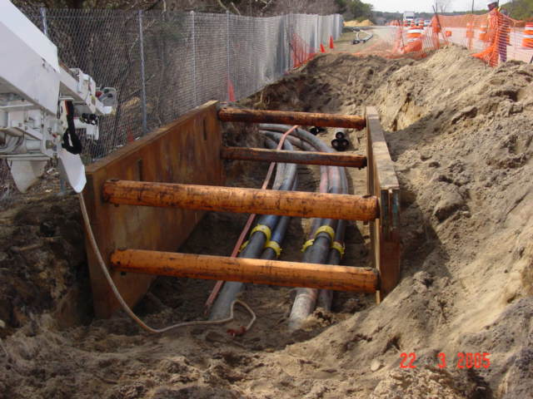
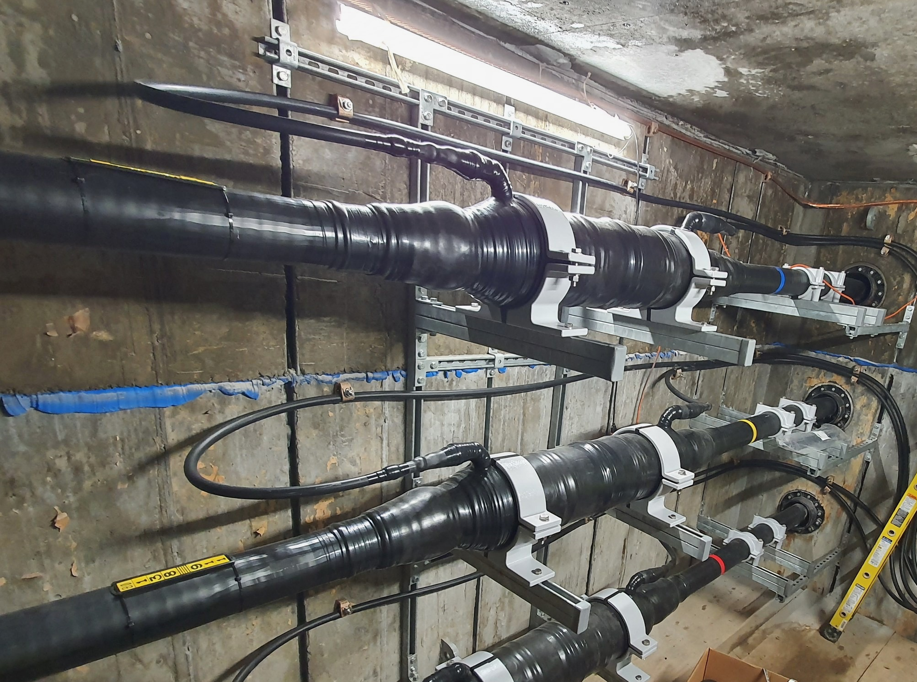
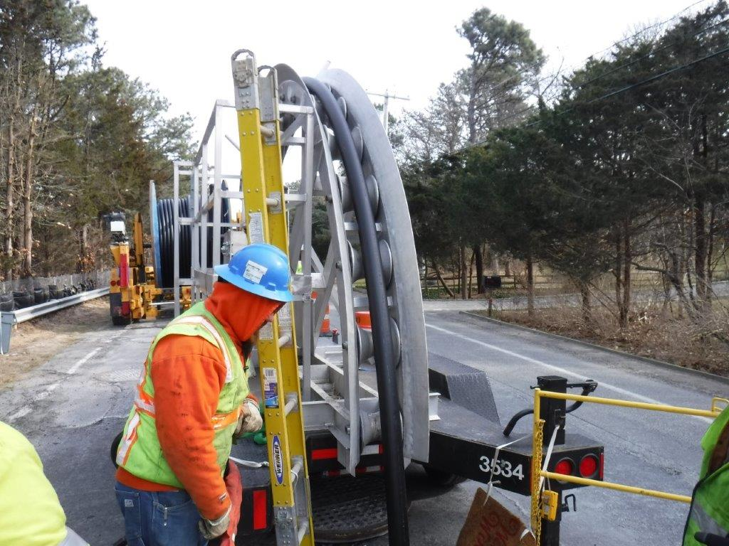
Newbridge Bypass Project
Construction Process Overview
Splice Vaults Installation:
One new underground vault will be installed within the LIPA right of way at the Newbridge substation to splice together the underground cable.
Existing Conduit:
During construction existing conduit lines will be tied into the new splice vault and new conduit will be installed within LIPA property to new termination points.
Restoration:
After completing the installation of the vaults, any excavated and disturbed areas will be seeded and restored.
Cable Installation:
Underground cable arrives on trucks specifically designed for their installation. Crews will pull cable from the new vault to existing vaults along the project route.
Cable Splicing:
Crews will set up a climate-controlled environment at the vault locations to splice the underground cables together. This activity is continuous for approximately one week for each vault.
Vault Installation
Conduit Installation
Substation Upgrades:
Equipment upgrades will be made within the LIPA-owned properties at the Stewart Avenue Substation and the Ruland Road Substation to create termination points for the connection of the 345 kV line.
Cable Splicing
Cable Installation
Permitting & Consultation Process
To construct the Project, PSEG Long Island will need, in addition to other necessary permits:
The New York State Public Service Commission's issuance of an amendment to the Article VII Certificate of Environmental Compatibility and Public Need and approval of an Environmental Management & Construction Plan (EM&CP).
Approval from or consultation with the New York Department of Environmental Conservation, New York State Office of Parks, Recreation & Historic Preservation and New York State Department of Transportation (DOT).
Consultation with Nassau County, Suffolk County, Town of Hempstead, Town of Huntington, and Village of Garden City.
For Questions About the Syosset to Oakwood Project,
Call or Text 631-792-6866 Email info@Syosset2Oakwood.com Visit www.Syosset2Oakwood.com

